Slide 1
Non-Deterministic Finite Automata (NFA)
Lecture 4
Rowaida AL-Amri

Slide 2
What is an NFA?
3. What is an NFA?
It is a type of finite automaton that, when reading a certain symbol, can:
- Move to one state.
- Or move to several states.
- Or not move to any state.
It is called Non-Deterministic because the transition is not necessarily uniquely determined.
Mathematical form: M=(Q,Σ,δ,q
But the transition function in an NFA is: represents the Power Set of the set of states Q.
That is, the result of the transition can be a set of states rather than just one state.

Slide 3
How does a NFA work?
When reading an Input string, an NFA can theoretically follow several paths at the same time.
The string is accepted if there is at least one path that reaches an accepting state after consuming the entire string..

Slide 4
Why do we use NFA?
Why do we use NFA?
1. Ease of design: For some languages, designing an NFA is much simpler than designing a DFA.
2. Suitable for Regular Expression: NFA is naturally used to convert a Regular Expression into an Automaton.
3. Building complex machines: Several NFAs can be combined easily.
4. Theoretical foundation: NFA is important for understanding:
Regular Languages , Regular Expressions , DFA , ε-NFA and Automata Equivalence

Slide 5
Nondeterministic finite accepters
Actually, any nondeterministic FA can be turned into a deterministic FA. That is why this class of automata is called Deterministic Finite Accepters.

Slide 6
Deterministic finite accepters
L = {a^{m}b^{n} : m, n ≥ 0}
Give a DFA that accepts this language

Slide 7
L = {a^{m}b^{n} : m, n ≥ 0}
What do we know about this language’s automaton?
Will it accept the empty string? If so, how do we represent that?
Will it accept strings that begin with an a?
Having begun with an a, seeing indefinitely many more a’s are OK ; the automaton can loop here.
Will it accept strings that begin with a b?
Once it sees a b, the automaton now has to be on guard.
As long as it continues to see b’s , it’s OK; loop.
If the string ends here, accept.
If it sees an a after seeing a b, reject.

Slide 8
L = {a^{m}b^{n} : m, n ≥ 0}
a
b
a
q₀
q₁
q₂
q₃
b
a
b
q₄
Does this automaton correspond to (represent, accept) the above language?
(Be careful!)

Slide 9
L = {a^{m}b^{n} : m, n ≥ 0}
a
b
a
q₀
q₁
q₂
b
a,b
Does this automaton correspond to (represent, accept) the above language? Is it deterministic?

Slide 10
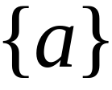


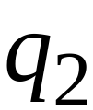
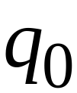

Nondeterministic Finite Accepter (NFA)
Alphabet =

Slide 11
Nondeterministic Finite Accepter (NFA)
Alphabet =
Two choices

Slide 12
Nondeterministic Finite Accepter (NFA)
Alphabet =
Two choices
No transition
No transition

Slide 13
First Choice

Slide 14
First Choice

Slide 15
First Choice

Slide 16
First Choice
All input is consumed
“accept”

Slide 17
Second Choice

Slide 18
Second Choice

Slide 19
Second Choice
No transition:
the automaton hangs

Slide 20
Second Choice
Input cannot be consumed
“reject”

Slide 21
تقبل آلة الحالة المنتهية الغير المحدودة الكلمة أو تكون الآلة محسوبة إذا تم قراءة كامل المتسلسلة (تم استهلاك المدخلات كليا) وكانت الآلة في حالة نهائية.

Slide 22

مثال
is accepted by the NFA:
“accept”
“reject”
because this computation
accepts

Slide 23
Rejection example

Slide 24
First Choice

Slide 25
First Choice
“reject”

Slide 26
Second Choice

Slide 27
Second Choice

Slide 28
Second Choice
“reject”

Slide 29
لا تقبل آلة الحالة المنتهية الغير المحدودة المتسلسلة (تكون الآلة غير محسوبة):
إذا تم قراءة جميع الرموز (المدخلات) ولم تصل الآلة إلى حالة نهائية (حالة قبول).
إذا لم يتم قراءة الرموز كاملاً (لم يتم قراءة الكلمة كاملاً).

Slide 30

Example :
is rejected by the NFA:
“reject”
“reject”
All possible computations lead to rejection
في جميع الحالات نصل إلى حالة رفض

Slide 31
Rejection example

Slide 32
First Choice

Slide 33
First Choice
No transition:
the automaton hangs

Slide 34
First Choice
Input cannot be consumed
لم يتم استهلاك كامل المدخلات
“reject”
No transition

Slide 35
Second Choice

Slide 36
Second Choice

Slide 37
Second Choice
No transition:
the automaton hangs

Slide 38
Second Choice
Input cannot be consumed
“reject”

Slide 39

is rejected by the NFA:
“reject”
“reject”
All possible computations lead to rejection

Slide 40
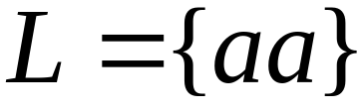
Language accepted:

Slide 41


Lambda Transitions
الانتقال بالكلمة الفارغة

Slide 44
(read head doesn’t move)

Slide 46
all input is consumed
“accept”
String is accepted

Slide 47
Rejection Example

Slide 49
(read head doesn’t move)

Slide 50
No transition:
the automaton hangs

Slide 51
Input cannot be consumed
“reject”
String is rejected

Slide 52
Language accepted:

Slide 53
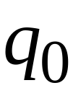


Another NFA Example

Slide 54


Slide 57
“accept”

Slide 58
Another String

Slide 65
“accept”

Slide 66
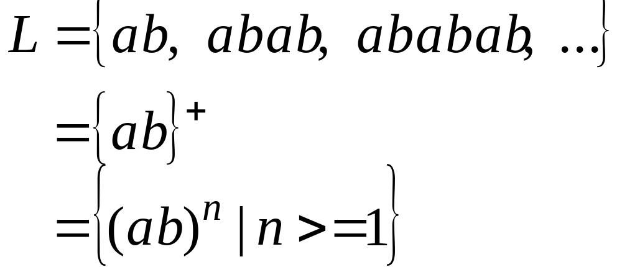
Language accepted

Slide 67

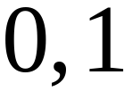

Another NFA Example

Slide 68
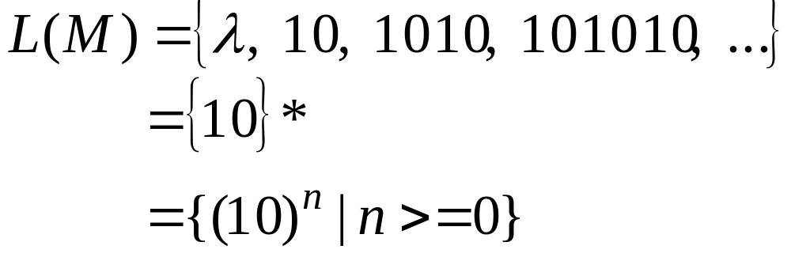
Language accepted

Slide 69
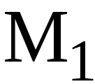
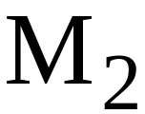
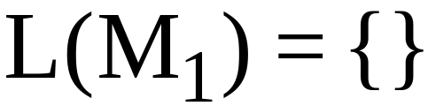
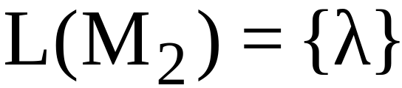
لاحظ أن الرمز لا يظهر مطلقاً على شريط المدخلات
Extreme automata:

Slide 70




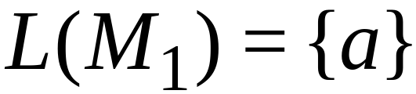
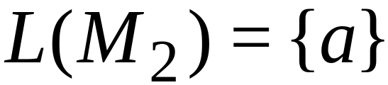
آلة الحالة المنتهية الغير محدودة (NFA) يمكن من خلالها التعبير عن اللغات بصورة أسهل من آلة الحالة المنتهية المحدودة (DFA) لاحظ الرسم أدناه:
NFA
DFA

Slide 71
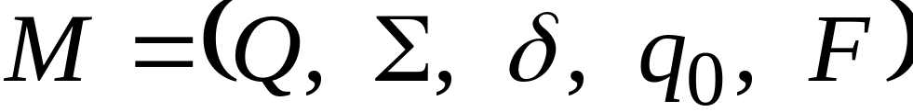
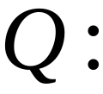
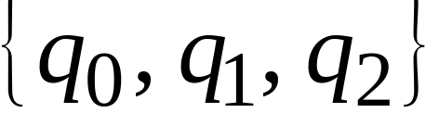

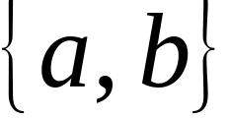
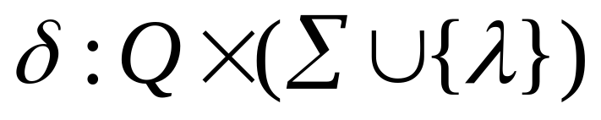
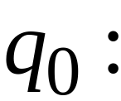

التعريف الشكلي (الرياضي) لآلة الحالة المنتهية الغير محدودة (NFA)
Set of states, i.e.
Input aplhabet, i.e.
Transition function
Initial state
Final states

Slide 72

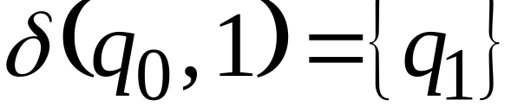
Transition Function

Slide 73
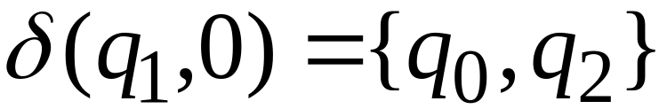

Slide 74
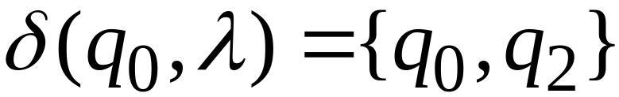

Slide 75
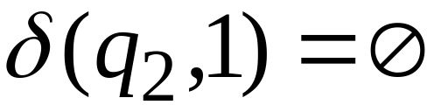
No transition

Slide 76

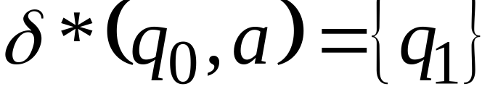





Extended Transition Function

Slide 77
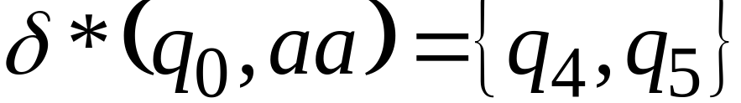

Slide 78
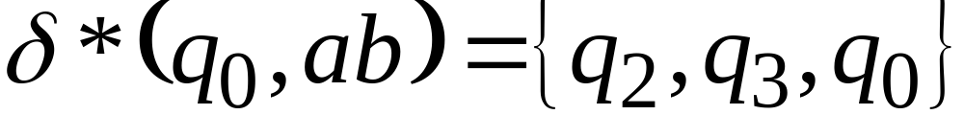

Slide 79

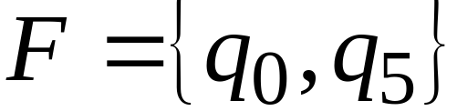
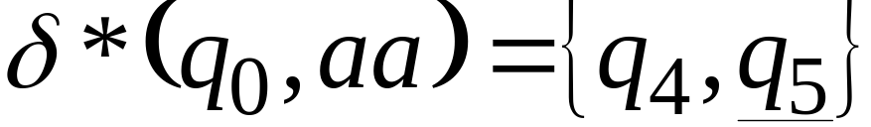
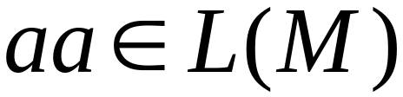
The Language of an NFA

Slide 80
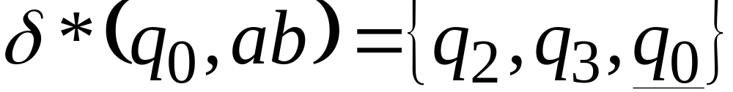
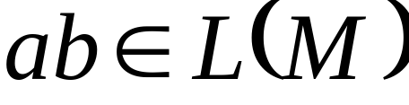

Slide 81
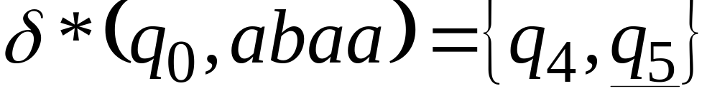
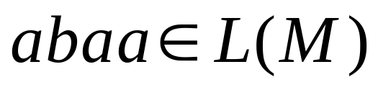

Slide 82
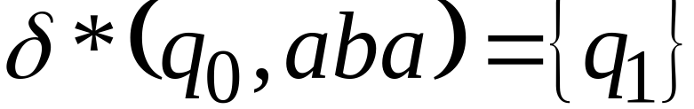
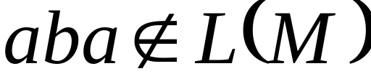

Slide 83
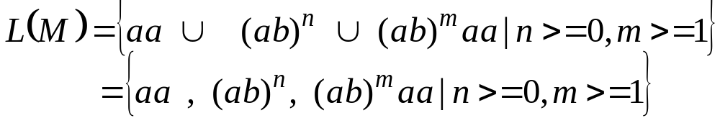

Slide 84
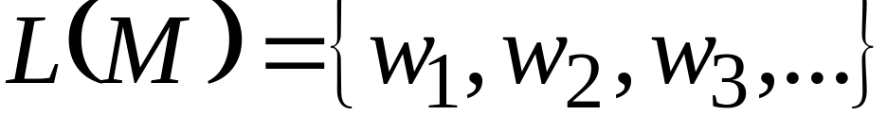
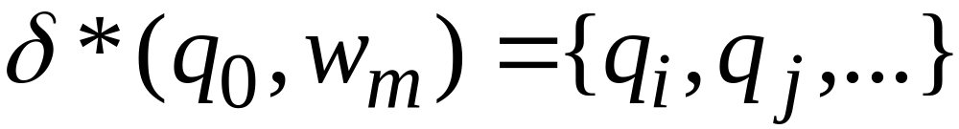
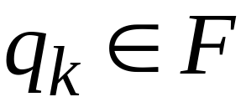
نقول أن الآلة تقبل المتسلسلة إذا أدت قراءة المتسلسلة إلى مجموعة حالات بينها واحدة على الأقل تنتمي إلى F (مجموعة حالات القبول).
The language accepted by NFA is:
where
and there is some
(final state)

Slide 85
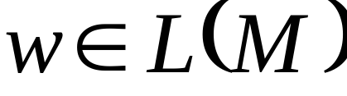
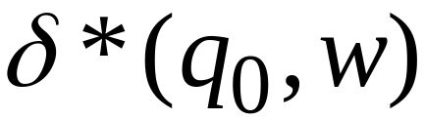





Slide 86
Some exercises
a
b
a,b
b
a
q₀
q₁
q₂
Use set notation to describe the language accepted by the above DFA

Slide 87
Some exercises
a
b
a,b
b
a
q₀
q₁
q₂
L(M) = {a^{n}b^{m}}, where n ≥ 0 and m ≥ 1

Slide 88

Limits of DFA
Theorem
For any alphabet , there exists a language that cannot be recognized by any finite automaton (the set of languages ​​is much larger than the one of automata)
Example 1
The language consisting of all palindromes over the alphabet , cannot be accepted by any DFA. Therefore it is not a regular language. If we take the alphabet = {a, b}, some examples of palindromes are :
{a, b, aa, bb, aaa, aba, . . .}

Slide 89
Limits of DFA
Example 2
there exists no DFA which can determine if the arithmetic expression parentheses are properly balanced
              a + b ) / c * (a - d) False
              a+ ( b / c * (a - d) + g) True
Example 3
there exists no DFA having the language L (M) = a^{n}b^{n}, n>=0

Slide 90
NDFA
An NDFA can be non-deterministic by:
having more than one edge with the same label originate from one vertex: see state q₁, which has two arcs labeled 0 emanating from it
having states without an edge originating from it for some symbol: see state q₂, which has no edges labeled 0 or 1. (This may be interpreted as a transition to the empty set.)
having lambda-transitions: see state q₀, which has an arc indicating that a λ-move from q₀ to q₂ is possible
1
0,1
q₀
q₁
q₂
0
λ

Slide 91
NDFA
A non-deterministic finite accepter (abbreviated NFA or NDFA) is defined by the quintuple : M = (Q, Σ, δ, q₀, F)
  Q is a finite, nonempty set of states
  Σ is finite set of input symbols called alphabet
  δ: Q × (Σ ∪ {λ}) → 2^{Q} is the transition function
  q₀ ∈ Q is the initial state
  F ⊆ Q is a set of final or “accepting” states

Slide 92
NDFA
Differences between a DFA and an NDFA:
(1) in an NDFA, the range of δ is in the powerset of Q (instead of just Q), so that from the current state, upon reading a symbol:
(a) more than one state might be the next state of the NDFA
(b) no state may be defined as the next state of the NDFA
(2) λ-moves are possible; that is, a transition from one state to another may occur without reading a symbol from the input string.

Slide 93
NDFA
The extended transition function for an NDFA is defined so that δ* (q_{i}, w) contains q_{j} iff there is a walk in the transition graph from q_{i} to q_{j} labeled w.
The language L accepted by an NDFA
M = (Q, Σ, δ, q₀, F) is defined as
L(M) = {w ∈ Σ* : δ* (q₀, w) ∩ F ≠ ∅}
That is, the language consists of all strings w for which there is a walk labeled w from the start state to a final state in the transition graph.

Slide 94
NDFA = DFA
One kind of automaton is more powerful than another if it can accept and reject some kinds of languages that the other cannot.
Two finite accepters are equivalent if both accept the same language, that is,
L(M₁) = L(M₂)
As mentioned previously, we can always find an equivalent DFA for any given NDFA. Therefore, NDFA’s are no more powerful than DFA’s.

Slide 95
NDFA → DFA
Theorem
Let L be the language accepted by a non-deterministic finite accepter M_{N} = (Q_{N}, Σ, δ_{N}, q₀, F_{N}) . Then there exists a deterministic finite accepter M_{D} = (Q_{D}, Σ, δ_{D}, q₀, F_{D}) such that L = L(M_{D}).
.

Slide 96
NDFA → DFA
Convert the following NDFA into an equivalent DFA
      Q = {1, 2, 3}
      Σ={a, b}
      δ= {(1, b, 2) (1, b, 3) (3, a, 1) (3, a, 2)}
      q₀= {1}
      F= {3}
The state transition diagram is :
3
a
1
b
a
b
2

Slide 97
NDFA → DFA
  The new transition function δ: Q × (Σ ∪ {λ}) → 2^{Q}
  Our new DFA will have a state labeled ∅
  construction of the new DFA is based on the following results:
  Q’ = P(Q)={∅, {1}, {2}, {3}, {1, 2}, {1, 3}, {2, 3}, {1, 2, 3}}
  Σ={a, b}
  q₀= q₀’={1}
  F= {{3}, {1, 3}, {2, 3}, {1, 2, 3}}
    δ (∅, a) = ∅ δ (∅, b) = ∅
    δ ({1}, a) = ∅ δ ({1}, b) = {2, 3}
    δ ({2}, a) = ∅ δ ({2}, b) = ∅
    δ ({3}, a) = {1, 2} δ ({3},b) = ∅
    δ ({1, 2}, a) = ∅ δ ({1, 2}, b) = {2, 3}
    δ ({1, 3}, a) = {1, 2} δ ({1, 3}, b) = {2, 3}
    δ ({2, 3}, a) = {1, 2} δ ({2, 3}, b) = ∅
    δ ({1, 2, 3}, a) = {1, 2} δ ({1, 2, 3}, b) = {2, 3}
3
a
1
b
a
b
2

Slide 98
NDFA → DFA
a
b
{2}
a
{∅}
b
{3}
b
If we eliminate the states which can not be achieved, we obtain the following DFA
a
a
a
b
a
{1}
b
{2,3}
{1, 2}
b
b
a
b
a
{1,3}
{1,2,3}
a
b
{∅}
It is easier to see that the language the automaton accepts is
L(M)={b (a b)^{n} / n ∈ N }
a
a
b
a
{1}
b
{2,3}
{1, 2}
b

Slide 99
Conclusion
Finite automaton can recognize in a program key words, identifiers and numbers, but not arithmetic expressions parentheses and Begin-End blocks. In the next chapters we will define more powerful machines to recognize a wider range of languages.

